Slide 1
Software Engineering
UNIT-II
B.Tech (CSE)-IV SEM
Dept of CSE

Slide 2

UNIT-II: Software Requirements: Functional and non-functional requirements, User requirements, System requirements, Interface specification, The Software requirements document.
Requirements engineering process: Feasibility studies, Requirements elicitation and analysis, Requirements validation, Requirements management.
SRI VASAVI ENGINEERING COLLEGE
PEDATADEPALLI, TADEPALLIGUDEM-534 101
Department of Computer Science & Engineering
Academic Year:2021-22
Course Title: Software Engineering
Course Code: V20CST07
Semester:IV
Syllabus

Slide 3
Software Requirements
The software requirements are description of features and functionalities of the target system. Requirements convey the expectations of users from the software product. The requirements can be obvious or hidden, known or unknown, expected or unexpected from client’s point of view.
What are Software requirements?
A condition or capability needed by a user to solve a problem or achieve an objective.
A condition or capability that must be met or possessed by a system or system component to satisfy a contract, standard, specification, or other formally imposed document.
Dept of CSE

Slide 4
Stakeholders
A stakeholder is a party that has an interest in a company and can either affect or be affected by the business. The primary stakeholders in a typical corporation are its investors, employees, customers, and suppliers.
Dept of CSE

Slide 5
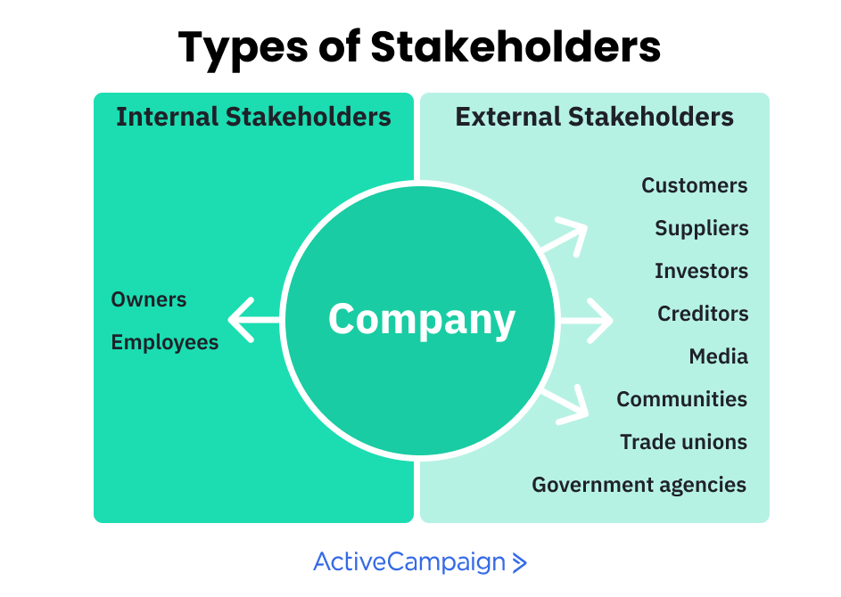
Dept of CSE

Slide 6
Requirements are generally split into two types: Functional and Non-functional requirements.
Functional requirements define what a product must do, what its features and functions are.
Nonfunctional requirements describe the general properties of a system. They are also known as quality attributes.
Functional Requirements:
These are the requirements that the end user specifically demands as basic facilities that the system should offer.
All these functionalities need to be necessarily incorporated into the system as a part of the contract.
These are represented or stated in the form of input to be given to the system, the operation performed and the output expected.
Dept of CSE

Slide 7
They are basically the requirements stated by the user which one can see directly in the final product, unlike the non-functional requirements.
Functional requirements may also explicitly state what the system shouldn‘t do.
Functional requirements should be:
Complete: All services required by the user should be defined
Consistent: should not have contradictory definition (also avoid ambiguity don‘t leave room for different interpretations)
Dept of CSE

Slide 8
Creating Functional Requirements:
When creating functional requirements, it is important to keep in mind that they should be specific, measurable, achievable, relevant, and time-bound (SMART). In other words, your functional requirements should:
Be specific about what the system should do
Be measurable so that you can tell if the system is doing it
Be achievable within the timeframe you have set
Be relevant to your business goals
Be time-bound so that you can track progress
By following these guidelines, you can be sure that your functional requirements are clear
Dept of CSE

Slide 9
Functional Requirements of a system should include the following things:
Details of operations conducted in every screen
Data handling logic should be entered into the system
It should have descriptions of system reports or other outputs
Complete information about the workflows performed by the system
It should clearly define who will be allowed to create/modify/delete the data in the system
How the system will fulfill applicable regulatory and compliance needs should be captured in the functional document
Dept of CSE

Slide 10
Types of Functional Requirements
Here are the most common functional requirement types:
Transaction Handling
Business Rules
Reporting Requirements
Administrative Functions
Authorization Levels
Audit Tracking
External Interfaces
Data Management
Legal and Regulatory Requirements
Dept of CSE

Slide 11
Benefits of Functional Requirement
Here, are the pros/advantages of creating a typical functional requirement document-
Helps you to check whether the application is providing all the functionalities that were mentioned in the functional requirement of that application
A functional requirement document helps you to define the functionality of a system or one of its subsystems.
Functional requirements along with requirement analysis help identify missing requirements. They help clearly define the expected system service and behavior.
Errors caught in the Functional requirement gathering stage are the cheapest to fix.
Support user goals, tasks, or activities
Dept of CSE

Slide 12
Examples:
To give you a better understanding of functional requirements, let’s take a look at some examples.
Example # 1 : A user shall be able to log into the system using their username and password.
In this example, the function is “login” and the behavior is “The system shall allow a user to login using their username and password.”
Example # 2 : The system shall calculate the sales tax for the user’s purchase.
In this example, the function is “calculate sales tax” and the behavior is “The system shall calculate the sales tax by multiplying the purchase price by the tax rate.”
Example # 3 : The system shall send a confirmation email to the user after they have successfully placed an order.
In this example, the function is “send confirmation email” and the behavior is “The system shall send a confirmation email to the user after they have successfully placed an order.”
Dept of CSE

Slide 13
NON-FUNCTIONAL REQUIREMENTS
These are basically the quality constraints that the system must satisfy according to the project contract.
The priority or extent to which these factors are implemented varies from one project to other.
Non-functional requirements explain the limitations and constraints of the system to be designed.
These requirements do not have any impact on the functionality of the application.
They are also called non-behavioral requirements.
Requirements that are not directly concerned with the specific functions delivered by the system
Typically relate to the system as a whole rather than the individual system features
Often could be deciding factor on the survival of the system (e.g. reliability, cost, response time)
Dept of CSE

Slide 14
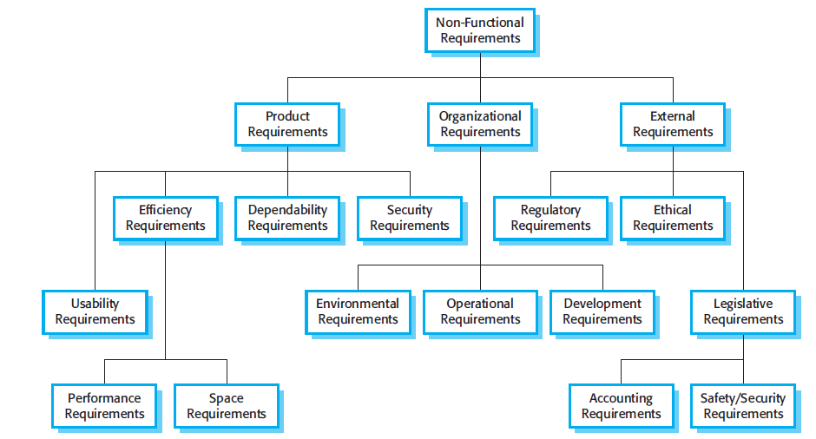
Non-Functional requirements classifications:
Dept of CSE

Slide 15
Product requirements These requirements specify or constrain the behavior of the software.
Examples include performance requirements on how fast the system must execute and how much memory it requires, reliability requirements that setout the acceptable failure rate, security requirements, and usability requirements.
Organizational requirements These requirements are broad system requirements derived from policies and procedures in the customer’s and developer’s organization.
Examples include operational process requirements that define how the system will be used, development process requirements that specify the programming language, the development environment or process standards to be used, and environmental requirements that specify the operating environment of the system.
Dept of CSE

Slide 16
External requirements This broad heading covers all requirements that are derived from factors external to the system and its development process.
These may include regulatory requirements that set out what must be done for the system to be approved for use by a regulator, such as a central bank;
Legislative requirements that must be followed to ensure that the system operates within the law;
and ethical requirements that ensure that the system will be acceptable to its users and the general public.
Dept of CSE

Slide 17
Efficiency requirements
Performance defines how fast a software system or a particular piece of it responds to certain users’ actions under a certain workload. In most cases, this metric explains how long a user must wait before the target operation happens (the page renders, a transaction is processed, etc.) given the overall number of users at the moment.
Scalability requirements
Scalability assesses the highest workloads under which the system will still meet the performance requirements.
Space requirements
This is a space requirement which specifies the maximum memory size required for the systemof the system
Dept of CSE

Slide 18
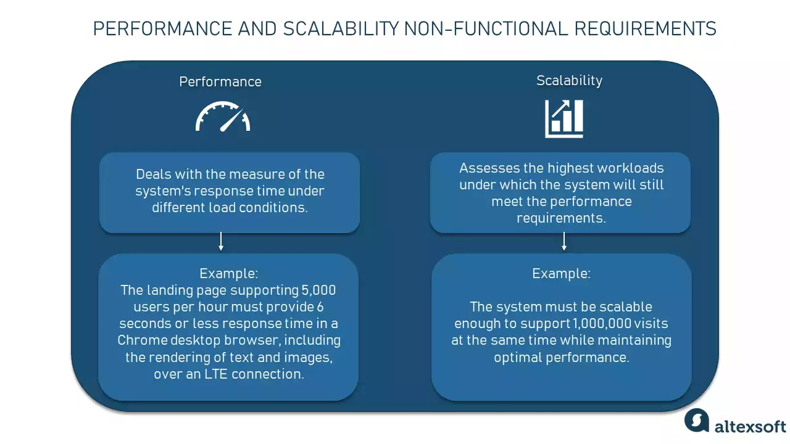
Dept of CSE

Slide 19
Portability Requirements
Portability determines how a system or its element can be launched within one environment or another. It usually includes hardware, software, or other usage platform specifications.
Compatibility Requirements
Compatibility, as an additional aspect of portability, defines how a system can coexist with another system in the same environment. For instance, software installed on an operating system must be compatible with its firewall or antivirus protection.
Dept of CSE

Slide 20
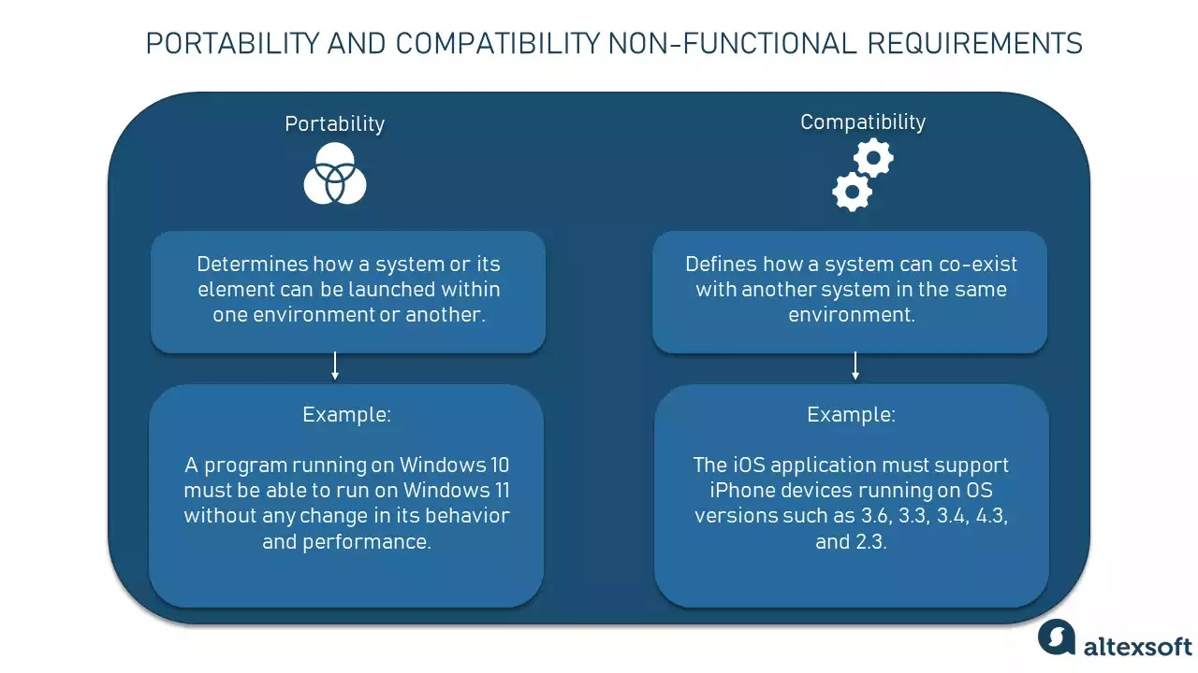
Dept of CSE

Slide 21
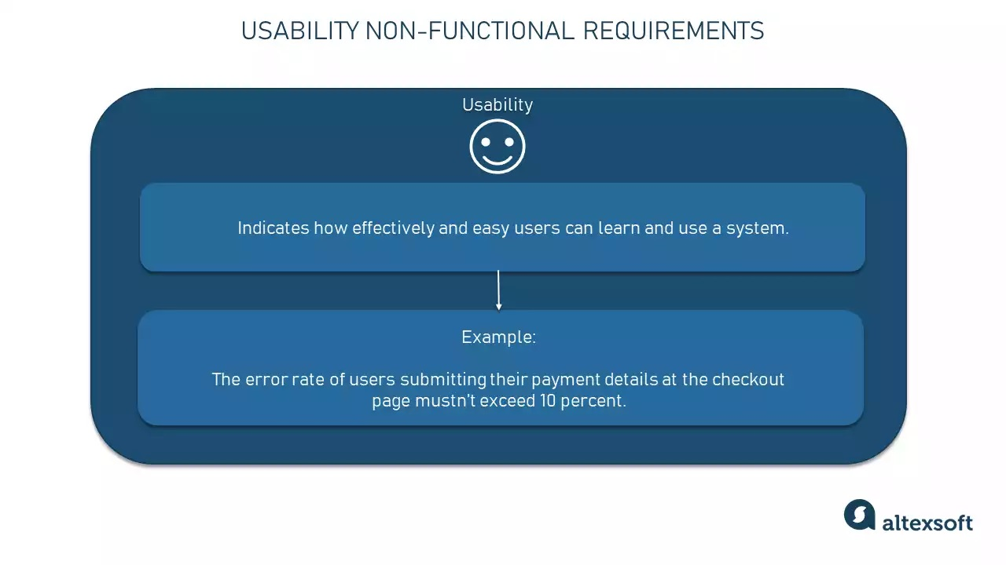
Usability requirement
Usability is yet another classical nonfunctional requirement that addresses a simple question: How hard is it to use the product? Defining these requirements isn’t as easy as it seems.
Dept of CSE

Slide 22
Dependability requirements
The dependability of a system reflects the user’s degree of trust in that system. It reflects the extent of the user’s confidence that it will operate as users expect and that it will not ‘fail’ in normal use.
Dependability covers the related systems attributes of reliability, availability, Maintainability and security. These are all interdependent.
Dept of CSE

Slide 23
Reliability specifies how likely the system or its element would run without a failure for a given period of time under predefined conditions.
Maintainability defines the time required for a solution or its component to be fixed, changed to increase performance or other qualities, or adapted to a changing environment.
Availability describes how likely the system is accessible to a user at a given point in time. While it can be expressed as an expected percentage of successful requests, you may also define it as a percentage of time the system is accessible for operation during some time period.
Dept of CSE

Slide 24
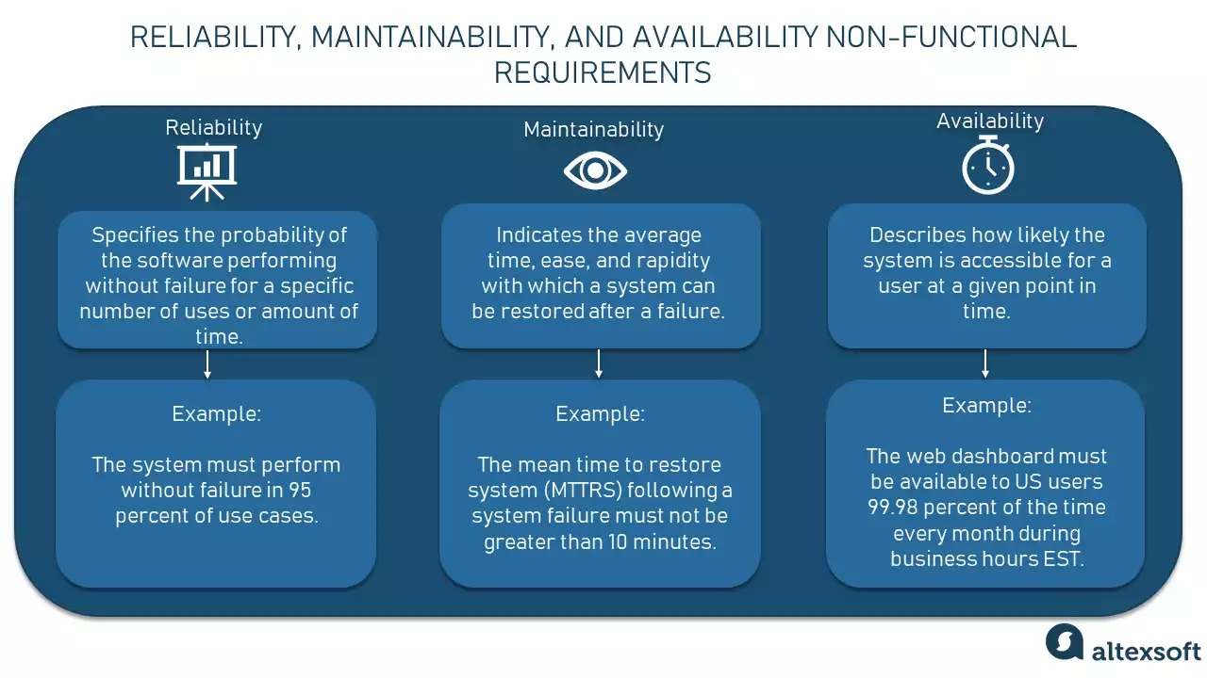
Dept of CSE

Slide 25
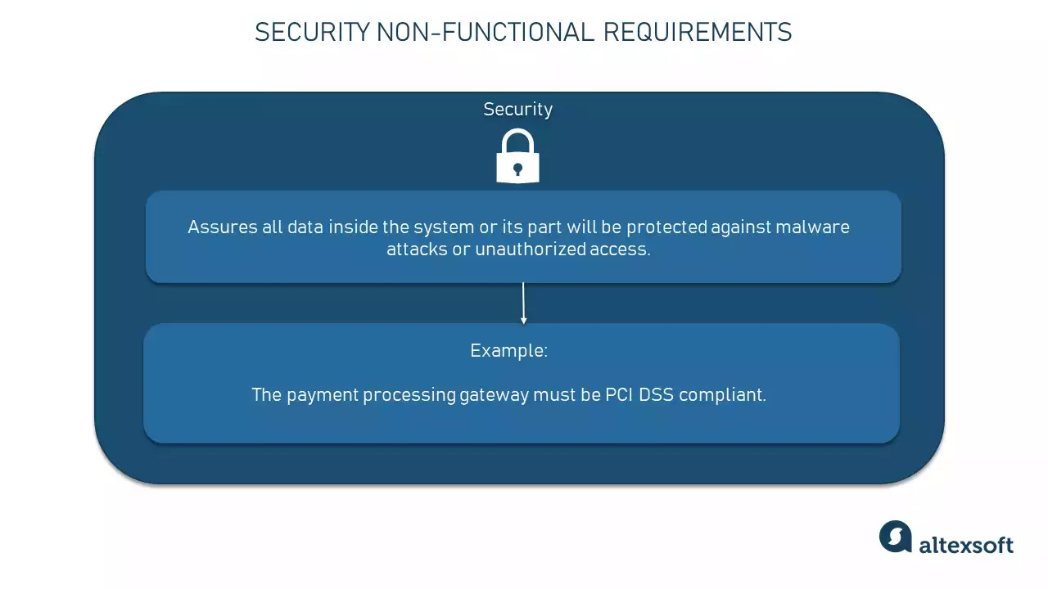
Security requirements
Security is a non-functional requirement assuring all data inside the system or its part will be protected against malware attacks or unauthorized access
Dept of CSE

Slide 26
Environment Requirements
The environment includes external factors that impact how your system performs. For example, humid weather and exposure to water may affect the speed or reliability of an application. An application's environment may also include the schedule on which it runs, such as 24 hours a day or only when the user launches it.
Operational Requirements
Operational requirements pertain to the scenarios within which the product will operate according to the procedures and operations in the organization.
Dept of CSE

Slide 27
Development Requirements:
It tells about which programming language the software should be developed and in which operating system the software should operate.
Regulatory Requirements:
Regulatory can be broadly defined as the regulations, and guidelines created by government and regulatory bodies applicable to an organization based on the industry in which it operates.
Legislative Requirements:
Regulatory can be broadly defined as the adherence to laws created by government legislations applicable to an organization based on the industry and jurisdiction in which it operates.
Dept of CSE

Slide 28
Ethical Requirements:
ethical requirements that ensure that the system will be acceptable to its users and the general public.
Dept of CSE

Slide 29
Advantages of Non-Functional Requirement
The nonfunctional requirements ensure the software system follow legal and compliance rules.
They ensure the reliability, availability, and performance of the software system
They ensure good user experience and ease of operating the software.
They help in formulating security policy of the software system.
Non-functional requirement is specified by technical peoples e.g. Architect, Technical leaders and software developers.
Example- 1) Emails should be sent with a latency of no greater than 12 hours from such an activity.
2) The processing of each request should be done within 10 seconds
3) The site should load in 3 seconds when the number of simultaneous users are > 10000
Dept of CSE

Slide 30
Parameters | Functional Requirement | Non-Functional Requirement
What it is | Verb | Attributes
Requirement | It is mandatory | It is non-mandatory
Capturing type | It is captured in use case. | It is captured as a quality attribute.
End-result | Product feature | Product properties
Capturing | Easy to capture | Hard to capture
Objective | Helps you verify the functionality of the software. | Helps you to verify the performance of the software.
Area of focus | Focus on user requirement | Concentrates on the user’s expectation.
Documentation | Describe what the product does | Describes how the product works
Type of Testing | Functional Testing like System, Integration, End to End, API testing, etc. | Non-Functional Testing like Performance, Stress, Usability, Security testing, etc.
Test Execution | Test Execution is done before non-functional testing. | After the functional testing
Product Info | Product Features | Product Properties
Dept of CSE

Slide 31
User requirements: User requirements are statements, in a natural language plus diagrams, of what services the system is expected to provide to system users and the constraints under which it must operate.
Often referred to as user needs, describe what the user does with the system, such as what activities that users must be able to perform. User requirements are generally documented in a User Requirements Document (URD) using narrative text. User requirements are generally signed off by the user and used as the primary input for creating system requirements.
An important and difficult step of designing a software product is determining what the user actually wants it to do. This is because the user is often not able to communicate the entirety of their needs and wants, and the information they provide may also be incomplete, inaccurate and self-conflicting.
Dept of CSE

Slide 32
The responsibility of completely understanding what the customer wants falls on the business analyst. This is why user requirements are generally considered separately from system requirements. The business analyst carefully analyzes user requirements and carefully constructs and documents a set of high quality system requirements ensuring that the requirements meet certain quality characteristics.
User requirements entail both functional and non-functional requirements that are understandable even by users without technical knowledge.
These requirements don’t contain details of the system design and don’t use technical expressions or formal notations.
Dept of CSE

Slide 33
System Requirements:
System requirements are more detailed descriptions of the software system’s functions, services, and operational constraints. The system requirements document should define exactly what is to be implemented. It may be part of the contract between the system buyer and the software developers.
System requirements are the building blocks developers use to build the system. These are the traditional “shall” statements that describe what the system “shall do.”
Along with that, it outlines both the functional and non-functional requirements the system should fulfil should understand by developer. Hence, it consists of all things the system must contain to construct or develop it.
Hence, the system requirements serve as a blueprint for the developer to follow defining the parts of a system that are to be implemented, so it acts as a contract between the client and contractor.
Dept of CSE

Slide 34
These requirements can be written in natural language, and also possesses more structured forms and graphical notations. However, as it’s primarily written for developers it possesses a detailed description of the project services. It uses natural language and is documented as a System Requirement Specification (SRS).
Dept of CSE

Slide 35
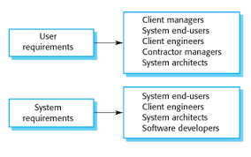
Dept of CSE

Slide 36
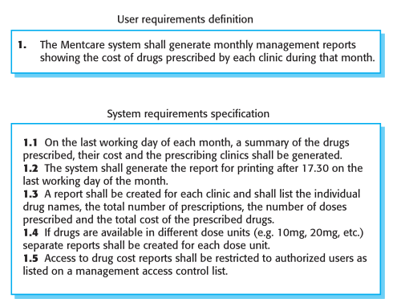
Dept of CSE

Slide 37
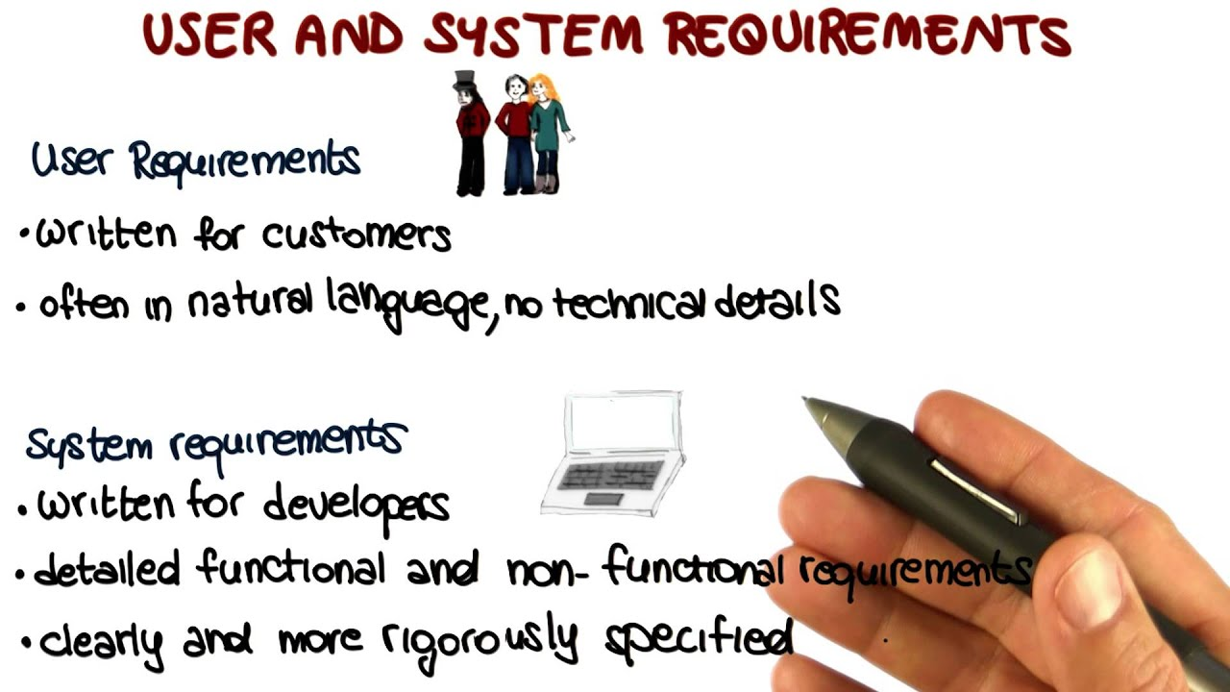
Dept of CSE

Slide 38
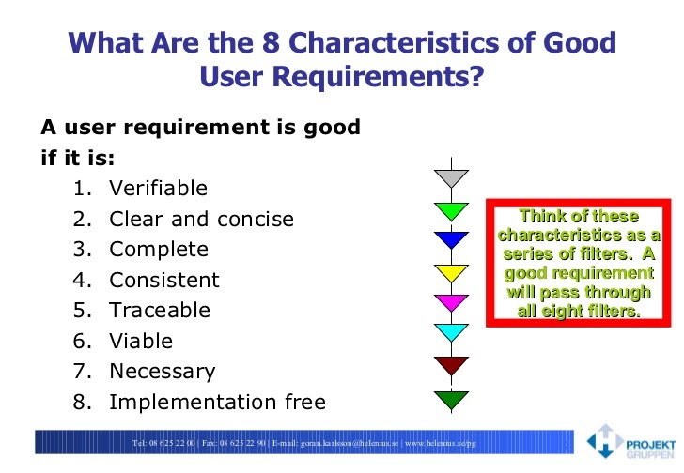
Dept of CSE

Slide 39
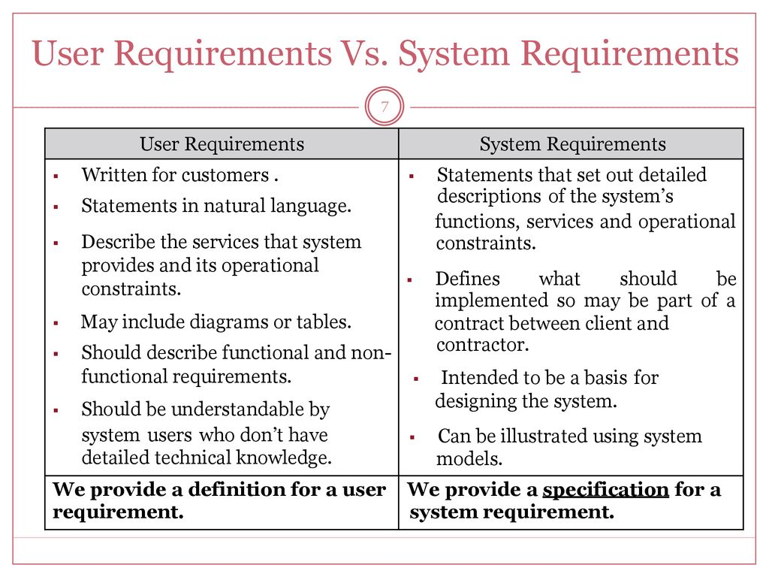
Dept of CSE

Slide 40
Interface Design:
Interface design is the process designers use to build interfaces in software or computerized devices, focusing on looks or style. Designers aim to create interfaces which users find easy to use and pleasurable. UI design refers to graphical user interfaces, voice-controlled interfaces and Gesture based interface.
Interface Design is between the User and Software or between the software components.
Dept of CSE

Slide 41
Interface Design Steps:
Designing the interface is an iterative process defined with the help of a spiral model. The designing of an interface starts from the mid of the spiral.
The spiral model encompasses four different frameworks those are:
  Interface Analysis and Modelling
  Design
  Construction
  Validation
Dept of CSE

Slide 42
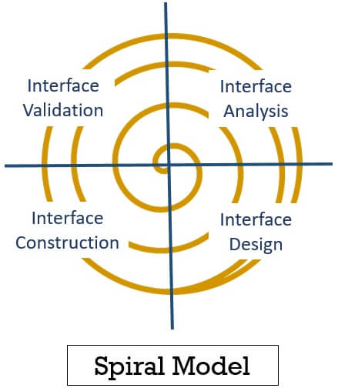
Dept of CSE

Slide 43
Interface Analysis and Modelling
Before designing any solution, you need to know what actually you have to design. In this framework, you have to study the user’s profile who will use this interface.
In this phase, the designer must understand the people who will interact with the system using the interface. What type of task the user or component has to perform to achieve the goal? Further, the designer must investigate the content that has to present as a part of the interface.
The designer must also analyze the environment where the user will interact with the system via an interface.
Dept of CSE

Slide 44
Interface Design
After completing the interface analysis, the designer identifies the task that the end-user requires. Interface designing is also an iterative process. The designer first identifies the objects and the operations performed on those objects.
The designer also has to define the events that would change the state of the user interface. Further, the designer has to outline each state of the user interface as it would appear to the end-user.
Interface Construction
After identifying the objects, operations and events the designer creates a prototype. This prototype helps in the evaluation of the real-world scenario. This process is also iterative and the construction continues till the prototype is approved for conducting real-world scenarios.
Dept of CSE

Slide 45
Interface validation
The validation phase is performed to see whether the interface can perform user tasks along with all the variations in the real world. Like, as to whether the interface can perform all general user tasks? Is it easy to use, and understand and we can accept it as a useful tool?
Dept of CSE

Slide 46
Interface Specification:
The Interface Specification is a document describes both the external interfaces between the product and its operating environment(users or other hardware components) and the internal interfaces between product components. Each interface needs to be described in sufficient detail that developers can implement it, integration testers can verify its correct functioning, reviewers can verify its correctness and completeness, maintainers can respect the interface when modifying components, and requirements analysts and system engineers can confirm the ability of the interface to facilitate collaboration among components to satisfy the product’s requirements. The following template shows contents of interface specification document.
Dept of CSE

Slide 47
Interface Specification Document Template:
1. Introduction
1.1 Document Purpose
1.2 Product Overview
1.3 Operating Environment
1.4 References
1.5 Assumptions
2. Interface Diagrams
3. Data Interfaces
3.1 Interface ID 1
3.1.1 Overview
3.1.2 Data Types
3.1.3 Interface File Formats
3.1.4 Communication Protocol
4. Software Interfaces
4.1 Interface ID 1
4.1.1 Overview
4.1.2 Interface Specification
4.1.3 Timing Issues
4.1.4 Communication Protocol
5. Hardware Interfaces
5.1 Interface ID 1
5.1.1 Overview
5.1.2 Connection
5.1.3 Data and Control Flow
6. User Interfaces
Dept of CSE

Slide 48
1. Introduction
1.1 Document Purpose
The purpose of this document is to identify and characterize the internal and external interfaces for the <Product Name>. The objectives of this interface specification are to facilitate clear and effective communication among the project stakeholders who are responsible for defining, specifying, implementing, testing, using, or conforming to these interfaces. The intended audience for this document include the project’s requirements analyst, system engineer or architect, software and hardware engineers, support and maintenance engineers, testers, marketers, and managers.
1.2 Product Overview
<Briefly state the name and purpose of the product to which this interface specification applies.
1.3Operating Environment
<Briefly summarize the operating environment for this product to help the reader understand the external interfaces. Possible aspects to address include:
Hardware platform configuration (e.g., standalone, mainframe, Web server-based workstations on a LAN)
Operating system; include the type and version of the operating system
Dept of CSE

Slide 49
1.4References
<List any other documents to which this Interface Specification refers. These may include user interface style guides, contracts, standards, device datasheets, architecture specifications, or a product requirements specification. Provide enough information that the reader could access each reference, such as title, author, version number, date, and URL.>
1.5Assumptions
<State any assumptions that are being made with respect to the product’s internal and external interfaces. Assumptions are statements that are regarded as being true in the absence of definitive knowledge that they are true. Known facts are not assumptions. Assumptions may also need to be documented in the specifications for individual interfaces.>
Dept of CSE

Slide 50
2. Interface Diagrams
<Unless already documented elsewhere, such as in an architecture specification, include a block diagram or other graphical representation of the architecture that illustrates the product’s external interfaces and the internal interfaces between components. If this diagram already exists elsewhere, include a hyperlink to that source here.>
3. Data Interfaces
<This section specifies both external and internal data interfaces. Data interfaces could be in the form of files or data streams.>
3.1 Interface ID 1
<Instead of actually saying “Interface ID 1”, state the unique identifier and name for the interface. Repeat this section for each discretely labeled data interface.>
Dept of CSE

Slide 51
3.1.1 Overview
Description of the data interface and its purpose
Location of the data (internal or external file, database, software component, hardware component, network)
Source and destination for the data (e.g., from product to external hardware device, or from component A to component B)
3.1.2Data Types
Name and definition
Encoding (ASCII, Unicode, XML, X12, EBCDIC)
Units
Valid range, including what to do if out-of-range value received and validity of null value
Default or initial value
Dept of CSE

Slide 52
3.1.3 Interface File Formats
<If this interface is used to transfer multiple files, provide the information requested below for each file.>
Sending (source) directory, file name, and physical location
Receiving (destination) directory, file name, and physical location
Average and maximum file size
3.1.4 Communication Protocol
<Describe the mechanisms used for data exchange, such as TCP/IP, FTP, etc.>
Dept of CSE

Slide 53
4. Software Interfaces
<This section describes the interfaces between product software components and external software or hardware components, as well as internal software–software and software–hardware component interfaces. Not all of the interface specification elements may apply to every software interface.>
4.1 Interface ID 1
<Instead of actually saying “Interface ID 1” state the unique identifier and name for the interface. Repeat this section for each discretely labeled software interface.>
4.1.1 Overview
Definition of the software interface
Interface purpose
Interface type (e.g., file, data stream, message)
Invariants
Assumptions
Dept of CSE

Slide 54
4.1.2 Interface Specification
Operation preconditions and post conditions
The software or hardware component that is the source of the data element
The software or hardware component(s) that receives the data element
Syntax – (Parameters, Return value, Exceptions thrown, Communication protocol )
Quality attributes
For message interfaces, specify the following information:
  Message name
  Message purpose
  Communication method
  Header record information
  Message data contents,
  End-of-message indicator o
  Expected response when the message is received
Dept of CSE

Slide 55
4.1.3 Timing Issues
<Indicate whether the interfacing components are to execute concurrently or sequentially. If concurrently, describe the method of inter-component synchronization to be used.>
4.1.4 Communication Protocol
Communication links, bands, frequencies, media, and their characteristics
Message formatting
Flow control, such as sequence numbering and buffer allocation
Data transfer rate
Routing, addressing, and naming conventions
Safety, security, and privacy considerations, such as encryption, user authentication, compartmentalization, and auditing
Characteristics of protocols the system must use for the interface, such as:
  Priority or layer of the protocol
  Packeting, including fragmentation and re-assembly, routing, and addressing
  Legality checks, error control, and recovery procedures
Dept of CSE

Slide 56
5 Hardware Interfaces
<This section describes the interfaces between product hardware components and external hardware components and those between internal hardware components. >
5.1 Interface ID 1
<Instead of actually saying “Interface ID 1” state the unique identifier and name for the interface. >
5.1.1 Overview
Definition of the hardware interface
Interface objectives
Interface type (e.g., cable, optical fiber, physical device)
External hardware component or device
Electrical, mechanical, and functional characteristics of the hardware interface
Assumptions
Dept of CSE

Slide 57
5.1.2 Connection
Physical media
Physical configuration (size, shape)
Hardware interface standard
Pin configuration and number
Voltage, frequency, and current
Grounding
Physical compatibility of the interfacing entities, such as dimensions, tolerances, loads, and plug compatibility
5.1.3 Data and Control Flow
Data rate and robustness
Input data name, type, and description
Output (returned) data name, type, description, and meaning
Control signal name, type, and description
Dept of CSE

Slide 58
6. User Interfaces
<If desired, you may include information about external user interfaces in this document. Alternatively, a separate user interface design document could contain that information.
The essential elements to include for user interfaces are:
  Standards and conventions to follow for the user interface, such as a product family user interface style guide, screen labeling conventions, text font and style conventions, function and shortcut key assignments, color schemes, branding, and specifications for standard types of dialog elements or controls, such as comment boxes, forms, error messages, and so forth.
  User interface architecture, showing the major dialog elements (screens, pages, forms, menus, dialog boxes, line prompts) and the permitted navigation connections between them.
  Screen layouts for individual user interface displays, including field positions and characteristics, allowed values for fields, values for drop-down lists, defaults, validations to perform on entered data, inter-field relationships, and so forth.>
Dept of CSE

Slide 59
Guidelines for Writing an Interface Specification
Focus on how elements interact with their environments, not on how elements are implemented.
Expose only what actors in an element's environment need to know.
If you don't want people to rely on a piece of information, don't include it in the interface documentation. Make it clear that information that "leaks" through an interface but is not included in its interface documentation can be used only at the peril of the actors that exploit it and of the system as a whole.
Keep in mind who will be using the interface documents and what types of information they will need. Avoid documenting more than is necessary.
Be as specific and as precise as you can, remembering that an interface specification that two different parties can interpret differently is likely to cause problems and confusion.
Dept of CSE

Slide 60
What is SRS Document
A software requirements specification (SRS) is a document that describes what the software will do and how it will be expected to perform. It also describes the functionality the product needs to fulfill all stakeholders (business, users) needs.
Why Use an SRS Document?
Development team require it for developing product according to the need.
Test plans are generated by testing group based on the describe external behavior.
Maintenance and support staff need it to understand what the software product is supposed to do.
Project manager base their plans and estimates of schedule, effort and resources on it and minimize the development time and cost.
customer rely on it to know that product they can expect.
It acts like a contract between developer and customer in documentation purpose.
Dept of CSE

Slide 61
Software Requirement Specification (SRS) Format
Software Requirement Specification (SRS) Format as name suggests, is complete specification and description of requirements of software that needs to be fulfilled for successful development of software system. These requirements can be functional as well as non-requirements depending upon type of requirement. The interaction between different customers and contractor is done because its necessary to fully understand needs of customers.
In order to form a good SRS, here you will see some points which can be used and should be considered to form a structure of good SRS. These are as follows :
Dept of CSE

Slide 62
1. Introduction
1.1 Purpose of this document
1.2 Scope of this document
1.3 Overview
2. General description
2.1 Product perspective
2.2 Product Functions
2.3 User Characteristics
2.4 General Constraints
2.5 Assumptions
3. Detailed Requirements
3.1 Functional Requirements
3.2 Interface Requirements
3.3 Performance Requirements
3.4 Design Constraints
3.5 Non-Functional Attributes
4. Preliminary Schedule and Budget
5. Appendices
Dept of CSE

Slide 63
1. Introduction :
  1.1 Purpose of this Document – At first, main aim of why this document is necessary and what’s purpose of document is explained and described.
  1.2 Scope of this document – In this, overall working and main objective of document and what value it will provide to customer is described and explained. It also includes a description of development cost and time required.
  1.3 Overview – In this, description of product is explained. It’s simply summary or overall review of product.
2. General description :
This section of the document should describe the general factors that affect the product and its requirements. This section does not state specfic requirements. Instead, it provides the background for those requirements, which are de_x001c_ned in detail in Section 3.
Dept of CSE

Slide 64
2.1 Product perspective:
This subsection of the document describe relation with other products if any. If the product is independent or it’s a part of other product, it should be stated here. A block diagram showing the major components of the larger system, interconnections, and external interfaces are mentioned.
2.2 Product Functions:
This subsection of the document should provide a summary of the major functions that the software will perform. For the sake of clarity, the functions should be organized in a way that makes the list of functions understandable to the customer or to anyone else reading the document for the _x001c_first time.
2.3 User Characteristics:
This subsection of the document should describe those general characteristics of the intended users of the product including educational level, experience, and technical expertise.
Dept of CSE

Slide 65
2.4 General Constraints:
This subsection of the document should provide a general description of any other items that will limit the developer's options. These include: a) Regulatory policies; b) Hardware limitations (e.g., signal timing requirements); c) Interfaces to other applications; d) Parallel operation; e) Audit functions;
f ) Control functions; g) Higher-order language requirements; h) Signal handshake protocols; i) Reliability requirements;
j) Criticality of the application; k) Safety and security considerations.
2.5 Assumptions :
This subsection of the document should list each of the factors that a_x001b_ect the requirements stated in the document. These factors are not design constraints on the system and/or software but are, rather, any changes to them that can affect the requirements in the document. For example, an assumption may be that a specifc operating system will be available on the hardware designated for the software product
Dept of CSE

Slide 66
3. Detailed Requirements:
This section of the document should contain all of the software requirements to a level of detail su_x001e_cient to enable designers to design a system to satisfy those requirements, and testers to test that the system satis_x001c_es those requirements
3.1 Functional Requirements:
In this, possible outcome of software system which includes effects due to operation of program is fully explained. All functional requirements which may include calculations, data processing, etc. are placed in a ranked order.
3.2 Interface Requirements:
In this, software interfaces which mean how software program communicates with each other or users either in form of any language, code, or message are fully described and explained.
Dept of CSE

Slide 67
3.3 Performance Requirements:
In this, how a software system performs desired functions under specific condition is explained. It also explains required time, required memory, maximum error rate, etc.
3.4 Design Constraints:
In this, constraints which simply means limitation or restriction are specified and explained for design team. Examples may include use of a particular algorithm, hardware and software limitations, etc.
3.5 Non-Functional Attributes:
In this, non-functional attributes are explained that are required by software system for better performance. An example may include Security, Portability, Reliability, Reusability, Application compatibility, Data integrity, Scalability capacity, etc.
Dept of CSE

Slide 68
4. Preliminary Schedule and Budget :
In this, initial version and budget of project plan are explained which include overall time duration required and overall cost required for development of project.
5. Appendices :
In this, additional information like references from where information is gathered, definitions of some specific terms, acronyms, abbreviations, etc. are given and explained.
Dept of CSE

Slide 69
Dept of CSE

Slide 70
Characteristics of good SRS
Correctness: User review is used to provide the accuracy of requirements stated in the SRS. SRS is said to be perfect if it covers all the needs that are truly expected from the system.
Completeness: Completeness of SRS indicates every sense of completion including the numbering of all the pages, resolving the to be determined parts to as much extent as possible as well as covering all the functional and non-functional requirements properly.
Consistency:
Requirements in SRS are said to be consistent if there are no conflicts between any set of requirements. Examples of conflict include differences in terminologies used at separate places, logical conflicts like time period of report generation, etc.
Unambiguousness:
A SRS is said to be unambiguous if all the requirements stated have only 1 interpretation. Some of the ways to prevent unambiguousness include the use of modeling techniques like ER diagrams, proper reviews and buddy checks, etc.
Dept of CSE

Slide 71
Ranking for importance and stability:
There should a criterion to classify the requirements as less or more important or more specifically as desirable or essential. An identifier mark can be used with every requirement to indicate its rank or stability.
Modifiability:
an SRS must clearly identify each and every requirement in a systematic manner. If there are any changes, the specific requirements and the dependent ones can be modified accordingly without impact the others.
Verifiability:
A SRS is verifiable if there exists a specific technique to quantifiably measure the extent to which every requirement is met by the system. For example, a requirement stating that the system must be user-friendly is not verifiable and listing such requirements should be avoided.
Traceability:
One should be able to trace a requirement to design component and then to code segment in the program. Similarly, one should be able to trace a requirement to the corresponding test cases.
Dept of CSE

Slide 72
Design Independence:
There should be an option to choose from multiple design alternatives for the final system. More specifically, the SRS should not include any implementation details.
Testability:
A SRS should be written in such a way that it is easy to generate test cases and test plans from the document.
Understandable by the customer:
An end user maybe an expert in his/her specific domain but might not be an expert in computer science. Hence, the use of formal notations and symbols should be avoided to as much extent as possible. The language should be kept easy and clear.
Right level of abstraction:
If the SRS is written for the requirements phase, the details should be explained explicitly. Whereas, for a feasibility study, fewer details can be used. Hence, the level of abstraction varies according to the purpose of the SRS.
Dept of CSE

Slide 73
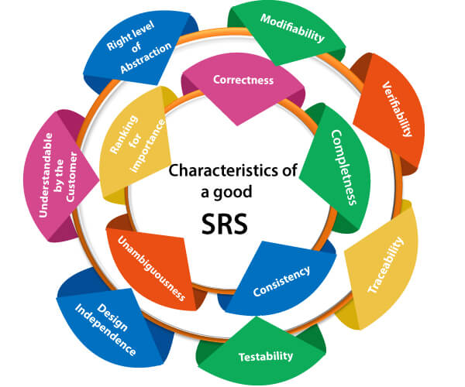
Dept of CSE

Slide 74
How to write an SRS document
Create an Outline (Or Use an SRS Template)
Your first step is to create an outline for your software requirements specification. This may be something you create yourself. Or you may use an existing SRS template.
Start With a Purpose
The introduction to your SRS is very important. It sets the expectation for the product you’re building.
Give an Overview of What You’ll Build
Your next step is to give a description of what you’re going to build. Is it an update to an existing product? Is it a new product? Is it an add-on to a product you’ve already created?
Dept of CSE

Slide 75
Detail Your Specific Requirements
The next section is key for your development team. This is where you detail the specific requirements for building your product.
Get Approval for the SRS
Once you’ve completed the SRS, you’ll need to get it approved by key stakeholders. And everyone should be reviewing the latest version of the document.
Dept of CSE

Slide 76
Requirement Engineering process
Requirement Engineering is the process of defining, documenting and maintaining the requirements. It is a process of gathering and defining service provided by the system. Requirements Engineering Process consists of the following main activities:
Feasibility study
Requirements elicitation
Requirements specification
Requirements verification and validation
Requirements management
Dept of CSE

Slide 77
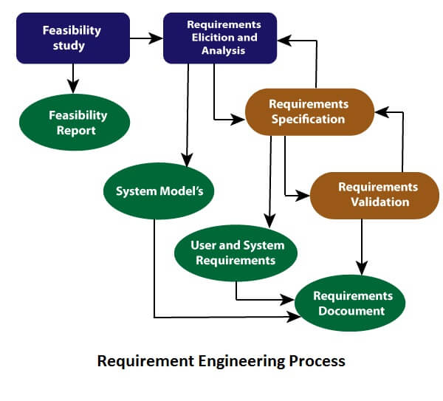
Dept of CSE

Slide 78
Feasibility Study
Feasibility Study in Software Engineering is a study to evaluate feasibility of proposed project or system. Feasibility study is one of stage among important four stages of Software Project Management Process. As name suggests feasibility study is the feasibility analysis or it is a measure of the software product in terms of how much beneficial product development will be for the organization in a practical point of view. Feasibility study is carried out based on many purposes to analyze whether software product will be right in terms of development, implantation, contribution of project to the organization etc.
Types of Feasibility Study :
The feasibility study mainly concentrates on bellow five mentioned areas. Among these Economic Feasibility Study is most important part of the feasibility analysis and Legal Feasibility Study is less considered feasibility analysis.
Dept of CSE

Slide 79
TechnicalFeasibility
In Technical Feasibility current resources both hardware & software along with required technology are analyzed/assessed to develop project. This technical feasibility study gives report whether there exists correct required resources and technologies which will be used for project development. Along with this, feasibility study also analyzes technical skills and capabilities of technical team, existing technology can be used or not, maintenance and up-gradation is easy or not for chosen technology etc.
The essential questions that help in testing the operational feasibility of a system include the following:
  Is the project feasible within the limits of current technology?
  Does the technology exist at all?
  Is it available within given resource constraints?
  Is it a practical proposition?
  Manpower- programmers, testers & debuggers
Dept of CSE

Slide 80
  Software and hardware
  Are the current technical resources sufficient for the new system?
  Can they be upgraded to provide to provide the level of technology necessary for the new system?
  Do we possess the necessary technical expertise, and is the schedule reasonable?
  Can the technology be easily applied to current problems?
  Does the technology have the capacity to handle the solution?
  Do we currently possess the necessary technology?
Dept of CSE

Slide 81
OperationalFeasibility
In Operational Feasibility degree of providing service to requirements is analyzed along with how much easy product will be to operate and maintenance after deployment. Along with this other operational scopes are determining usability of product, Determining suggested solution by software development team is acceptable or not etc.
The essential questions that help in testing the operational feasibility of a system include the following:
  Does current mode of operation provide adequate throughput and response time?
  Does current mode provide end users and managers with timely, pertinent, accurate and useful formatted information?
  Does current mode of operation provide cost-effective information services to the business?
Dept of CSE

Slide 82
  Could there be a reduction in cost and or an increase in benefits?
  Does current mode of operation offer effective controls to protect against fraud and to guarantee accuracy and security of data and information?
  Does current mode of operation make maximum use of available resources, including people, time, and flow of forms?
  Does current mode of operation provide reliable services
  Are the services flexible and expandable?
  Are the current work practices and procedures adequate to support the new system?
  If the system is developed, will it be used?
  Manpower problems
  Labour objections
  Manager resistance
  Organizational conflicts and policies
  Social acceptability
  Government regulations
  Does management support the project?
  Are the users not happy with current business practices?
Dept of CSE

Slide 83
  Will it reduce the time (operation) considerably?
  Have the users been involved in the planning and development of the project?
  Will the proposed system really benefit the organization?
  Does the overall response increase?
  Will accessibility of information be lost?
  Will the system affect the customers in considerable way?
  Legal aspects
  How do the end-users feel about their role in the new system?
  What end-users or managers may resist or not use the system?
  How will the working environment of the end-user change?
  Can or will end-users and management adapt to the change?
Dept of CSE

Slide 84
Economic Feasibility -
In Economic Feasibility study cost and benefit of the project is analyzed. Means under this feasibility study a detail analysis is carried out what will be cost of the project for development which includes all required cost for final development like hardware and software resource required, design and development cost and operational cost and so on. After that it is analyzed whether project will be beneficial in terms of finance for organization or not.
Dept of CSE

Slide 85
Possible questions raised in economic analysis are:
  Is the system cost effective?
  Do benefits outweigh costs?
  The cost of doing full system study
  The cost of business employee time
  Estimated cost of hardware
  Estimated cost of software/software development
  Is the project possible, given the resource constraints?
  What are the savings that will result from the system?
  Cost of employees' time for study
  Cost of packaged software/software development
  Selection among alternative financing arrangements (rent/lease/purchase)
Dept of CSE

Slide 86
Legal Feasibility –
In Legal Feasibility study project is analyzed in legality point of view. This includes analyzing barriers of legal implementation of project, data protection acts or social media laws, project certificate, license, copyright etc. Overall it can be said that Legal Feasibility Study is study to know if proposed project conform legal and ethical requirements.
Schedule Feasibility –
In Schedule Feasibility Study mainly timelines/deadlines is analyzed for proposed project which includes how many times teams will take to complete final project which has a great impact on the organization as purpose of project may fail if it can’t be completed on time.
Dept of CSE

Slide 87
Feasibility Study Process :
The below steps are carried out during entire feasibility analysis.
Information assessment
Information collection
Report writing
General information
Need of Feasibility Study :
Feasibility study is so important stage of Software Project Management Process as after completion of feasibility study it gives a conclusion of whether to go ahead with proposed project as it is practically feasible or to stop proposed project here as it is not right/feasible to develop or to think/analyze about proposed project again.
Along with this Feasibility study helps in identifying risk factors involved in developing and deploying system and planning for risk analysis also narrows the business alternatives and enhance success rate analyzing different parameters associated with proposed project development.
Dept of CSE

Slide 88
Requirements Elicitation
This is also known as the gathering of requirements. Here, requirements are identified with the help of customers and existing systems processes, if available
It is related to the various ways used to gain knowledge about the project domain and requirements.
The various sources of domain knowledge include customers, business manuals, the existing software of same type, standards and other stakeholders of the project.
The techniques used for requirements elicitation include interviews, brainstorming, task analysis, Delphi technique, prototyping, etc.
Elicitation does not produce formal models of the requirements understood. Instead, it widens the domain knowledge of the analyst and thus helps in providing input to the next stage.
Dept of CSE

Slide 89
Requirements Elicitation & Analysis
It’s a process of interacting with customers and end-users to find out about the domain requirements, what services the system should provide, and the other constrains.
The requirements elicitation and analysis has 4 main process steps.
Requirements Discovery
Requirements Classification & Organization
Requirements Prioritization & Negotiation
Requirements Specification
Dept of CSE

Slide 90
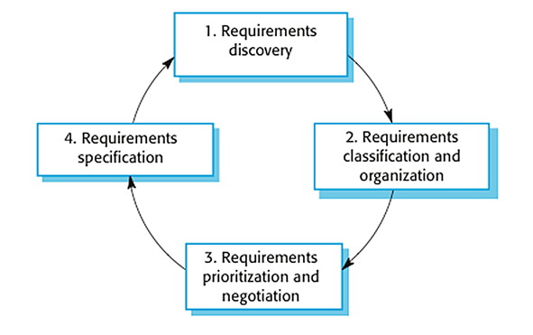
The process of requirements elicitation and analysis
It shows that it’s an iterative process with a feedback from each activity to another. The process cycle starts with requirements discovery and ends with the requirements document. The cycle ends when the requirements document is complete.
Dept of CSE

Slide 91
1. Requirements Discovery: It’s the process of interacting with, and gathering the requirements from, the stakeholders about the required system and the existing system (if exist). It can be done using some techniques, like interviews, scenarios, prototypes, etc, which help the stockholders to understand what the system will be like.
2. Requirements Classification & Organization: It’s very important to organize the overall structure of the system. Putting related requirements together, and decomposing the system into sub components of related requirements. Then, we define the relationship between these components.
3. Requirements Prioritization & Negotiation: This activity is concerned with prioritizing requirements and finding and resolving requirements conflicts through negotiations until you reach a situation where some of the stakeholders can compromise.
4. Requirements Specification: It is the process of writing down user and system requirements into a document. The requirement should be clear, easy to understand, complete and consistent.
Dept of CSE

Slide 92
1. Requirements Discovery
It’s the process of interacting with, and gathering the requirements from, the stakeholders about the required system and the existing system (if exist).
It can be done using some techniques, like interviews, scenarios, prototypes, etc, which help the stockholders to understand what the system will be like.
Gathering and understanding the requirements is a difficult process
That’s because stakeholders may not know what exactly they want the software to do, or they may give un-realistic requirements.
They may give different requirements, which will result in conflict between the requirements, so we have to discover and resolve these conflicts.
Also there might be some factors that influence on the stakeholder’s decision, like for example, managers at a company or professors at the university want to take a full control over the management system.
Dept of CSE

Slide 93
Interviews
In Interviews, requirements engineering teams put the questions to the stakeholder about the system that’s currently used, and the system to be developed, and hence they can gather the requirements from the answers.
The questions fall under two categories:
Closed-Ended questions: A pre-defined set of question.
Open-Ended questions: There is no a pre-defined expected answer, they are more of generic questions. It’s used to explore issues that’s not clear in a less structured way.
However, interviews aren’t so helpful in understanding the domain requirements. This is for two reasons:
Domain requirements may be expressed using special domain terminologies, and software engineers often find it difficult to understand and it’s easy for them to misunderstand.
Sometimes stakeholders won’t tell you some requirements because they assume it’s so fundamental and it doesn’t worth mentioning, or they find it difficult to explain, which won’t be taken into consideration in the requirements.
Dept of CSE

Slide 94
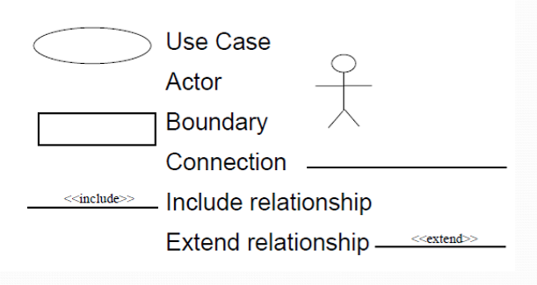
Use Cases & Scenarios
The use cases and scenarios are two different techniques, but, usually they are used together.
Use cases identify interactions between the system and it’s users or even other external systems (using graphical notations), while a scenario is a textual description of one or more of these interactions.
Use case involves some symbols to describe the system:
Dept of CSE

Slide 95
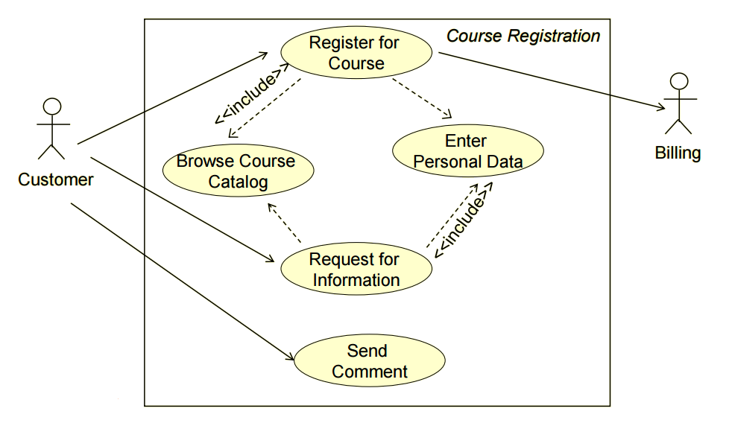
Dept of CSE

Slide 96
Actors: Are those who interact with the system; human or other systems
Interaction (Use Case): It denotes the name of the interaction (verb). It’s represented as a named ellipse.
Connection: Lines that links between the actors and the interactions.
Include Relationship: It denotes a connection between two interactions when an interaction is invoked by another. As an example, splitting a large interaction into several interactions.
Exclude Relationship: It denotes a connection between two interactions when you want to extend an interaction by adding an optional behavior, but you can use the main interaction on it’s own without the extending interaction.
SCENARIOS
Now, we are going to use scenarios to describe the interactions in each use case textually. They should have a format and include the following:
A description of the initial situation.
A description of the flow of the events or interactions with the system
A description of the exceptions, or in other words, what can go wrong, and how it can be handled.
Any concurrent activities should be mentioned
A description of the final state.
Dept of CSE

Slide 97
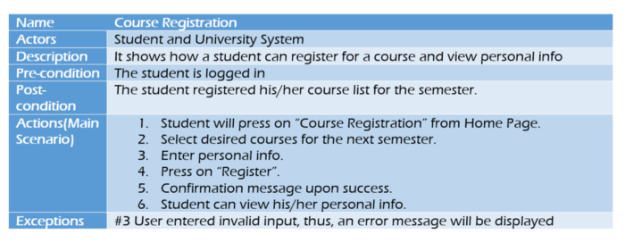
Dept of CSE

Slide 98
The next two phases are about analyzing requirements: determining whether the stated requirements are clear, complete, consistent and unambiguous, group related requirements and organize them into related components, and resolving any apparent conflicts.
2. Requirements Classification & Organization
It’s very important to organize the overall structure of the system.
Putting related requirements together, and decomposing the system into sub components of related requirements. Then, we define the relationship between these components.
What we do here will help us in the decision of identifying the most suitable architectural design patterns.
Dept of CSE

Slide 99
3.Requirements Prioritization & Negotiation
Requirements prioritization is the practice of identifying and managing the importance of various requirements to acknowledge the limited resources available.
Most stakeholders view all requirements as equally important. They don’t always understand that development teams are working with limited time and resources. This can cause friction between the different parties. By performing requirements prioritization techniques, you can ease that tension and help stakeholders understand the limitations of development teams.
We shouldn’t reach a situation where a stakeholder is not satisfied because his requirements is not taken into consideration.
Prioritizing your requirements will help you later to focus on the essentials and core features of the system, so you can meet the user expectations. It can be achieved by giving every piece of function a priority level. So, functions with higher priorities need higher attention and focus.
Dept of CSE

Slide 100
Requirements specification
It’s the process of writing down the user and system requirements into a document. The requirements should be clear, easy to understand, complete and consistent.
This activity is used to produce formal software requirement models. All the requirements including the functional as well as the non-functional requirements and the constraints are specified by these models in totality. During specification, more knowledge about the problem may be required which can again trigger the elicitation process.
The models used at this stage include
ER diagrams
Data flow diagrams(DFDs)
Function decomposition diagrams(FDDs)
Data dictionaries, etc.
Dept of CSE

Slide 101
Requirements verification and validation
Verification and Validation (V&V) are independent procedures that are used together for checking that a product, service, or system meets requirements and specifications and that it fulfills its intended purpose. These are critical components of a quality management system such as ISO 9000.
Dept of CSE

Slide 102
Verification: It refers to the set of tasks that ensures that the software correctly implements a specific function.
whether the requirements have been specified right.
Validation: It refers to a different set of tasks that ensures that the software that has been built is traceable to customer requirements.
If requirements are not validated, errors in the requirement definitions would propagate to the successive stages resulting in a lot of modification and rework.
whether the right requirements have been specified.
The main steps for this process include:
The requirements should be consistent with all the other requirements i.e. no two requirements should conflict with each other.
The requirements should be complete in every sense.
The requirements should be practically achievable.
Reviews, buddy checks, making test cases, etc. are some of the methods used for this.
It’s a process of ensuring the specified requirements meet the customer needs. It’s concerned with finding problems with the requirements.
Dept of CSE

Slide 103
Requirements validation is the process of checking that requirements defined for development, define the system that the customer really wants. To check issues related to requirements, we perform requirements validation. We usually use requirements validation to check error at the initial phase of development as the error may increase excessive rework when detected later in the development process.
In the requirements validation process, we perform a different type of test to check the requirements mentioned in the Software Requirements Specification (SRS), these checks include:
Completeness checks
Consistency checks
Validity checks
Realism checks
Ambiguity checks
Verifiability
The output of requirements validation is the list of problems and agreed on actions of detected problems. The lists of problems indicate the problem detected during the process of requirement validation. The list of agreed action states the corrective action that should be taken to fix the detected problem
Dept of CSE

Slide 104
Requirement management
Requirement management is the process of analyzing, documenting, tracking, prioritizing and agreeing on the requirement and controlling the communication to relevant stakeholders. This stage takes care of the changing nature of requirements. It should be ensured that the SRS is as modifiable as possible so as to incorporate changes in requirements specified by the end users at later stages too. Being able to modify the software as per requirements in a systematic and controlled manner is an extremely important part of the requirements engineering process.
Requirements management is often viewed as a five-step development process. The project manager and key stakeholders will evaluate the requirements during each step of the process. These steps are outlined below:
Step 1: Investigation
Typically, the first step will be that of fact-finding or investigation. Participants identify their goals and examine the requirements necessary for meeting those goals.
Dept of CSE

Slide 105
Step 2: Feasibility
The next stage of requirements management involves the feasibility of the project in terms of cost. This helps to shape the project as it moves forward toward design and development. The project manager and stakeholders must determine exactly what is required to ensure the project is viable from an economic standpoint.
Step 3: Design
After the investigation and feasibility stages, the project then moves forward to the design phase. There will inevitably be some changes to the requirements that will need to be communicated and subsequently addressed by those responsible for various aspects of the design. An important part of requirements management is determining if these changes will affect the cost or scope of the project.
Step 4: Construction and Testing
Once the design has been approved, a prototype or working model is typically constructed and put through a series of tests.
This helps the team ensure that the project will be able to progress according to schedule and stay within budget. The project requirements are often adjusted and refined during the testing stage of requirements management and must be documented accordingly.
Dept of CSE

Slide 106
Step 5: Release
Once the product is finally approved, it is released. As the product enters into use, there is still the need for ongoing requirements management related to proposed upgrades, add-ons, improvements, marketing, sales, and the like. These will be documented and addressed during the investigation phase of the next release.
The most fundamental aspect of requirements management is the need to communicate effectively.
Dept of CSE

Slide 107
THANK YOU
Dept of CSE

